Slide 1
Building Bridges With Badges:
How Metrics Help You Find the Right Crowd
Katie Schueths

Slide 2






What is a Badge?
A visible symbol of ANYTHING someone wants other people to know
Stickers on a notebook
Virtual badges - Github, Gitlab, Twitter, Facebook
Physical pin or patch on clothing
Printed in promotional media
Katie Schueths: kschueths@indeed.com

Slide 3


Why do you need badges?
You want to easily convey important information that is MEANINGFUL to your INTENDED audience.
Could be:
Accomplishments
Important metrics
Affiliations
Badges only have the value your audience assigns them
Katie Schueths: kschueths@indeed.com

Slide 4
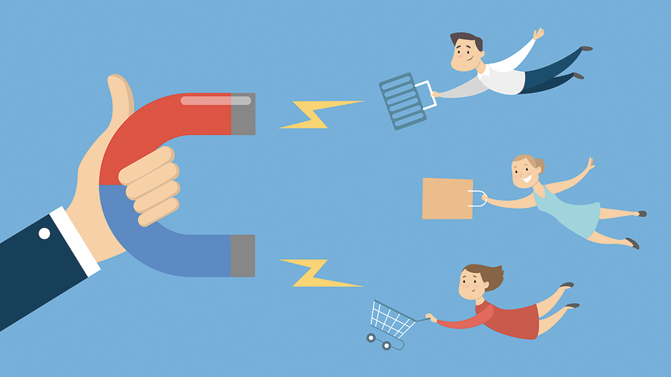
Picking the right badge matters!
Anything can be measured. You need to decide what is important:
What will attract your desired contributors and volunteers?
What do you want your ideal volunteers to care about?
But we qualify for all of them…
Pick what you want people to know at a first glance
You can put more information in an about section
Katie Schueths: kschueths@indeed.com

Slide 5
A quick look…
You use badges to get the attention of people who recognize and care about the information you are displaying
You are hosting a large diversity, equity, and inclusion open source event that happens to have the most food trucks onsite ever gathered in one place at the same time in your region.
This event qualifies for badges from a national food TV network and CHAOSS
Do you want to target an audience with a diversity, equity and inclusion health metrics badge or a badge for the most food trucks at an event?
Do you want volunteers who are primarily DEI advocates or food aficionados?
Katie Schueths: kschueths@indeed.com

Slide 6

Why Your Metrics Matter
Your reputation reflects on your volunteers and contributors.
People care about their reputation. They want to be affiliated with projects and events with a good reputation/high value.
Your volunteers and contributors will talk about your successes and use it as a highlight when promoting themselves. They are your evangelists!
Katie Schueths: kschueths@indeed.com

Slide 7

Finding Badges
Network
Google and investigate
Reach out to organizations that are known by your audience/industry
Look at other events/projects similar to yours
Reputable sources have a greater perceived value!
Katie Schueths: kschueths@indeed.com

Slide 8



Stay in Contact
Katie Schueths
@katie_schueths
kschueths@indeed.com

